Slide 1
COSC1127/1125
Artificial Intelligence
Semester 2, 2024
Prof. Sebastian Sardiña
Lab designed & delivered by Harry Porter (AI24 tutor)
Prolog Lab
Associated repo: https://github.com/COSC1127-AI/prolog-lab

Slide 2
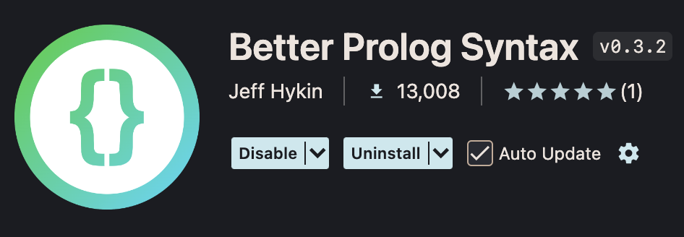
Setup: Visual Studio Code
Install “Better Prolog Syntax”!
Configure Visual Studio Code to recognise the .pl extension as denoting Prolog files (this may conflict with Perl files). One way is to add this to your user settings.json file:
"files.associations": { "*.pl": "prolog" }

Slide 3
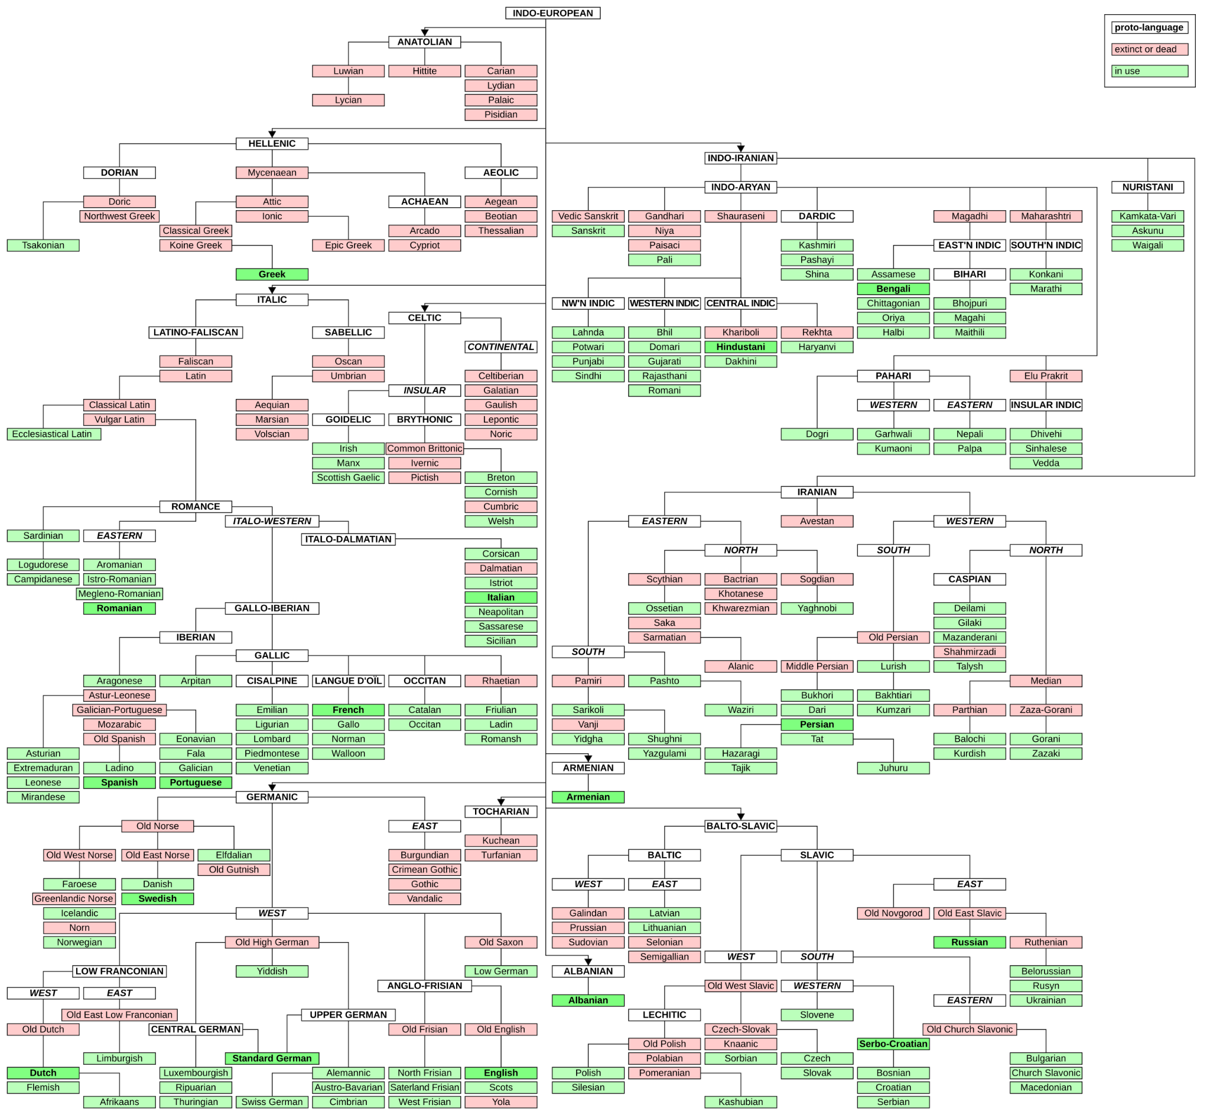
Knowledge Base
Separate knowledge from reasoning processes!
This language family tree denotes four pieces of information—which languages are:
Attested, where speakers or written records exist (green and red nodes).
Unattested, which have been reconstructed from their children (white nodes).
Extinct, where there are no living speakers (red nodes).
Descendants of a given parent language (edges).
https://en.wikipedia.org/wiki/Indo-European_languages#/media/File:Indo-European_language_tree_(with_major_international_languages_highlighted).svg

Slide 4
Propositional Logic: Facts
Prolog programs are queries over databases of facts.
Each fact (or atom) represents a proposition, an assertion that something is true.
Facts start with a lower-case letter; statements end with a full-stop.
% Refer to language-database-propositional.pl!
englishIsLanguage.
spanishIsLanguage.
classicalLatinIsExtinct.

Slide 5
Propositional Logic: Queries
Queries ask whether or not some assertion holds, given the knowledge base.
$ swipl
?- consult("language-database-propositional.pl"). % Add database to the KB.
true.
?- englishIsLanguage.
true.

Slide 6
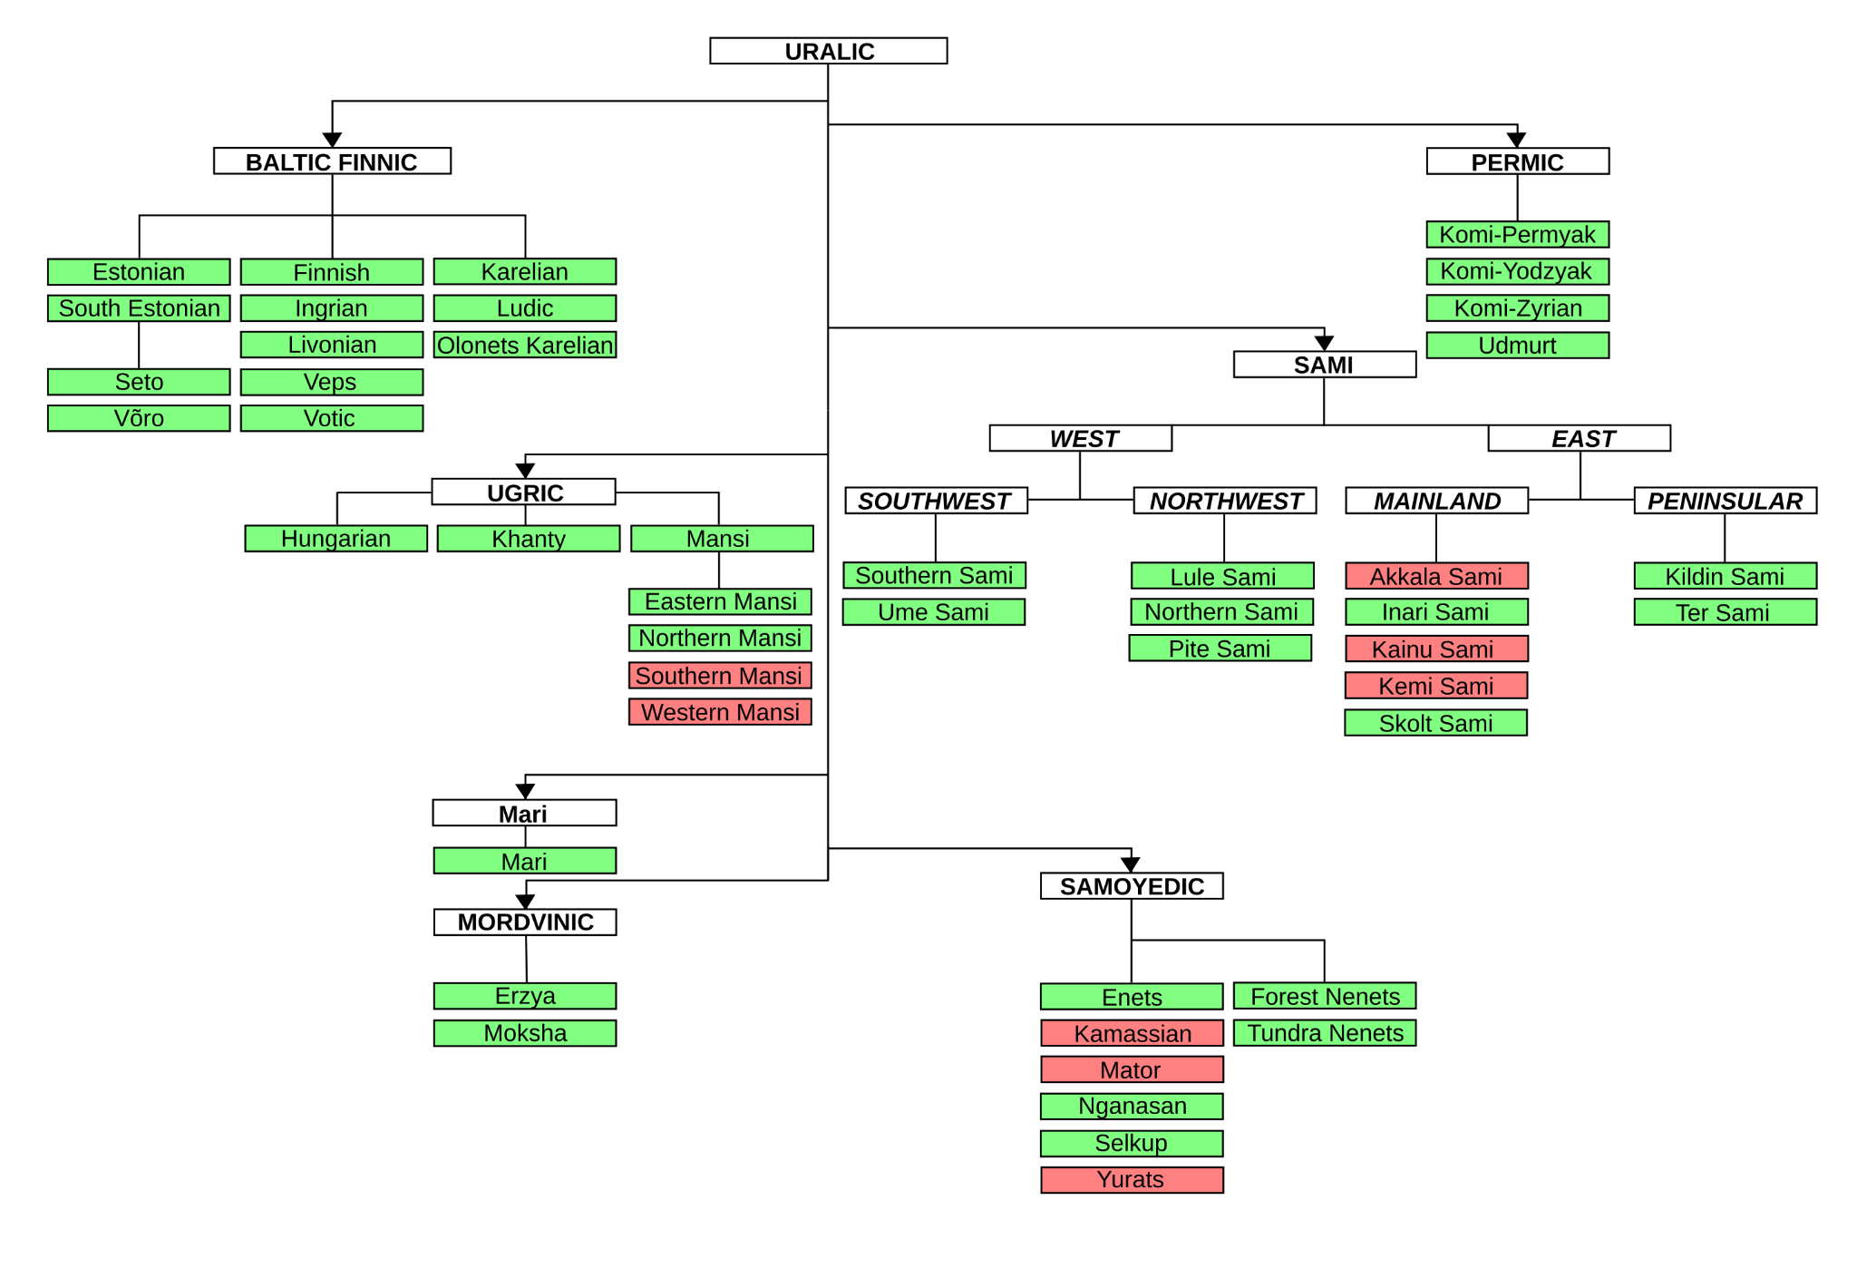
balticFinnicIsParentOfEstonian
uralicIsProtoLanguage
hungarianIsLanguage
yuratsIsExtinct
https://en.wikipedia.org/wiki/Uralic_languages#/media/File:UralicTree.svg

Slide 7
First-Order Logic: Predicates
Predicates represent information with more structure than propositions.
They are defined by their functor and arity (number of arguments).
functor/arity
isParent/2 represents predicates with functor isParent and 2 arguments: e.g. isParent("Old West Norse","Icelandic").
Atoms can be "quoted" inside predicates, or begin with a lower-case letter.
We can represent our family trees using four predicates:
isLanguage/1 means the language is attested.
isProtoLanguage/1 means the language is unattested.
isExtinct/1 means the language isn’t spoken anymore.
isParent/2 means that the latter language evolved from the former.
Use language-database-predicates.pl for the following exercises!

Slide 8
isParent("Baltic Finnic","Estonian")
isParent/2
isProtoLanguage/1
isLanguage/1
isProtoLanguage("Uralic")
isLanguage("Hungarian")
isExtinct/1
isExtinct("Yurats")
https://en.wikipedia.org/wiki/Uralic_languages#/media/File:UralicTree.svg

Slide 9
Unification
Unification is the process of matching terms to each other, by checking if they can be made equal.
Identical ground (containing no variables) facts unify.
?- harry = harry.
true.
Ground facts that aren’t identical won’t unify.
?- harry = sebastian.
false.

Slide 10
Unification
Identical ground predicates, or complex terms, also unify.
?- professor(sebastian,sardiña) = professor(sebastian,sardiña).
true.
?- professor(sebastian,sardiña) = tutor(harry,porter).
false.

Slide 11
Unification: Variables
Variables represent (and unify with) arbitrary terms.
Variables begin with an uppercase letter.
isParent("Old West Norse",X).
Variables can be instantiated to any value. Different variables are unified to produce a single variable.
?- X = harry.
X = harry.
?- X = professor(sebastian,sardiña).
X = professor(sebastian,sardiña).
?- X = Y, Y = harry.
X = Y, Y = harry.

Slide 12
Unification: Variables
Unification instantiates variables.
If a variable occurs multiple times, all instances are unified.
?- X = professor(sebastian,Y), Y = sardiña.
X = professor(sebastian,sardiña),
Y = sardiña.
Unification can occur in either term being unified.
?- professor(X,sardiña) = professor(sebastian,Y).
X = sebastian,
Y = sardiña.
?- professor(sebastian,sardiña), professor(X,X). % Why does this fail?

Slide 13
Unification: Queries
When queried, Prolog attempts to unify queries with some part of the knowledge base—if successful, the query is true.
Every possible unification is returned, one by one.
$ swipl
?- consult("language-database-predicates.pl"). % Update your knowledge base.
true.
?- isParent("Old West Norse",X).
X = "Faroese" ;
X = "Greenlandic Norse" ;
X = "Icelandic" ;
X = "Norn" ;
X = "Norwegian".

Slide 14
Rules
Rules derive new facts from the existing knowledge base.
Our knowledge base contains the predicate isParent/2. What if we want to specify the opposite: isChild/2?
isParent("Achaean","Arcado").
isParent("Achaean","Cypriot").
isParent("Aeolic","Aegean").
% Etc.

Slide 15
Rules isChild/2
True if language X is the child of language Y.
Query is first unified with the head. Then, if the body holds, the head is true.
isChild(X,Y) :- isParent(Y,X).
Head
Body

Slide 16
Rules isChild/2
Add isChild/2 to our knowledge base, then:
?- consult("language-database-predicates.pl").
true.
?- consult("<your-prolog-file>.pl"). % Should contain the isChild/2 rule.
true.
?- isChild("English",X).
X = "Old English".
?- isChild(X,"Old English").
X = "English" ; % Type the semicolon to request another possible unification.
X = "Scots" ;
X = "Yola". % REMEMBER: Every possible unification will be returned.
Test this out yourself! What happens if you query isChild(A,B)?

Slide 17
Rules isSpoken/1
True if language X is still spoken.
isSpoken(X) :- isLanguage(X), \+ isExtinct(X).
X is spoken IF X is a language AND NOT X is extinct.
Every possible unification is tried for each body predicate—backtracking!

Slide 18
Rules isSibling/2
True if language X is the sibling of language Y.
isSibling(X,Y) :- isParent(Z,X), isParent(Z,Y), X \= Y.
X and Y are siblings IF Z is X’s parent AND Z is Y’s Parent AND X and Y do not unify.
Why is this required?

Slide 19
Rules isSibling/2
True if language X is the sibling of language Y.
isSibling(X,Y) :- isParent(Z,X), isParent(Z,Y), X \= Y.
X and Y are siblings IF Z is X’s parent AND Z is Y’s Parent AND X and Y do not unify.
Why is this required?

Slide 20
Rules isCousin/2
True if languages X and Y are cousins.
isCousin(X,Y) :-
isParent(A,X),
isParent(B,Y),
isSibling(A,B),
X \= Y.
X and Y are cousins IF
A is X’s parent AND
B is Y’s parent AND
A and B are siblings AND
X and Y do not unify.

Slide 21
Rules isGrandparent/2
True if language X is the grandparent of language Y.
isGrandparent(X,Y) :-
isParent(X,Z),
isParent(Z,Y).
X is the grandparent of Y IF
X is Z’s parent AND
Z is Y’s parent.

Slide 22
Recursion isAncestor/2
True if language X is the ancestor of language Y.
isAncestor(X,Y) :- isParent(X,Y).
X is the ancestor of Y IF X is Y’s parent, OR
BASE CASE!
isAncestor(X,Y) :- isParent(X,Z), isAncestor(Z,Y).
X is the ancestor of Y IF X is Z’s parent AND Z is the ancestor of Y.
RECURSIVE CASE!
CHALLENGE! Try to write isDescendant/2. It can be very similar to isAncestor/2!

Slide 23
Rules shareAncestor/3
True if languages X and Y share an ancestor Z.
shareAncestor(X,Y,Z) :-
isAncestor(Z,X),
isAncestor(Z,Y),
X \= Y.
Z is the ancestor of both X and Y IF
Z the ancestor of X AND
Z the ancestor of Y AND
X and Y do not unify.
This predicate returns every ancestor! How can we return only the most recent ancestor?

Slide 24
Rules shareMostRecentAncestor/3
True if languages X and Y share an ancestor A and no children of A are ancestors of X and Y.
shareMostRecentAncestor(X,Y,A) :-
shareAncestor(X,Y,A),
\+ (
isParent(A,B),
shareAncestor(X,Y,B)
).
A is the most recent ancestor of X and Y IF
A is an ancestor of both X and Y AND
NOT
A is B’s parent AND
B is an ancestor of both X and Y.
Negation applied to entire parenthesised expression!
CHALLENGE! What is \+ (isParent(A,B), shareAncestor(X,Y,B)) equivalent to by De Morgan’s Law?

Slide 25
Lists
Lists are ordered collections of terms:
[sebastian,sardiña,harry,porter]
They can be unified into their head (first element) and tail (list of subsequent elements):
[sebastian|sardiña,harry,porter]
HEAD
TAIL

Slide 26
Unification: Lists
Lists unify according to their elements.
?- [X,Y] = [sebastian,sardiña].
X = sebastian,
Y = sardiña.
They can be unified into their head and tail.
?- [H|T] = [sebastian, sardiña, harry, porter].
H = sebastian,
T = [sardiña, harry, porter].
?- [X,Y|T] = [sebastian, sardiña, harry, porter].
X = sebastian,
Y = sardiña,
T = [harry, porter].

Slide 27
Unification: Lists
Empty lists only unify with themselves.
?- [] = [].
true.
?- [] = [sebastian,sardiña].
false.
Lists with a single element have an empty tail!
?- [X] = [harry].
X = harry.
?- [X] = [X|[]].
true.
?- [X] = [sebastian,sardiña]. % Why does this unification fail?
false.

Slide 28
List Operations
Let’s rewrite some built-in predicates for operating on lists!
`member/2` tests if a term occurs within a list.
?- member(sardiña,[harry,sebastian,sardiña]).
true.
`length/2` counts the number of elements in a list.
?- length([harry,sebastian,sardiña],N).
N = 3.
`append/3` concatenates two lists.
?- append([harry,porter],[sebastian,sardiña],X).
X = [harry,porter,sebastian,sardiña].

Slide 29
List Operations hasLength/2
Our version of the built-in length/2 predicate.
hasLength([],0).
[] has length 0.
_ denotes an anonymous variable!
Used wherever a variable is only referenced once, so it doesn’t need a name.
hasLength([_|T],N) :-
hasLength(T,M),
N is M + 1.
A list with tail T has length N IF
T has length M AND
N equals M + 1.
REMEMBER! An empty list will not unify with any list that contains elements: ?- [] = [X] is false.

Slide 30
List Operations contains/2
Our version of the built-in member/2 predicate.
contains([X|_],X).
A list with head X contains X.
contains([H|T],X) :-
H \= X,
contains(T,X).
A list with head H and tail T contains X IF
H and X do not unify AND
T contains X.
What happens if we query contains([],X)?

Slide 31
List Operations isConcatenated/3
Our version of the built-in append/3 predicate.
isConcatenated([],L,L).
A list L concatenated with [] is L.
A list with head X and tail A concatenated with a list L is X prepended to a list B IF
isConcatenated([X|A],L,[X|B]) :- isConcatenated(A,L,B).
B is A concatenated with L.
This one is a bit trickier! Take your time tracing through it with `?- trace.` and try different queries!

Slide 32
List Operations areLanguagesRelated/2
Lists can also contain predicates! Unification behaves as usual.
areLanguagesRelated([],[]).
areLanguagesRelated([languages(X,Y)|A],[areRelated(X,Y)|B]) :-
shareMostRecentAncestor(X,Y,_),
areLanguagesRelated(A,B).
areLanguagesRelated([languages(X,Y)|A],[notRelated(X,Y)|B]) :-
\+ shareMostRecentAncestor(X,Y,_),
areLanguagesRelated(A,B).
CHALLENGE! Exclude all terms that don’t unify with `languages/2` from the result list.

Slide 33
Lists Knowledge Base
We can represent our isParent/2 predicate using lists!
% Predicates like this:
isParent("Old East Norse", "Swedish").
isParent("Old East Norse", "Danish").
% Can be expressed like this:
isParent("Old East Norse", ["Swedish", "Danish"]).
Use languages-database-lists.pl for the following predicates!

Slide 34
Mutual Recursion hasDescendants/2
List all the descendants of language X, assuming languages are their own descendants.
hasDescendants(X,[X]) :- \+ isParent(X,_).
hasDescendants(X,[X|Y]) :- isParent(X,Z), haveDescendants(Z,Y).
CHALLENGE! Annotate hasDescendants/2.
haveDescendants([],[]).
haveDescendants([X|Y],Z) :-
hasDescendants(X,A),
haveDescendants(Y,B),
isConcatenated(A,B,Z).
[] has descendants [].
A list of languages with head X and tail Y has descendants Z IF
X has descendants A AND
Y has descendants B AND
Concatenating A and B yields Z.

Slide 35
Mutual Recursion hasSpokenDescendants/2
Count all non-extinct descendants of language X, assuming languages are their own descendants.
hasSpokenDescendants(X,0) :- \+ isParent(X,_), isExtinct(X).
hasSpokenDescendants(X,1) :- \+ isParent(X,_), \+ isExtinct(X).
hasSpokenDescendants(X,N) :- isParent(X,Y), isExtinct(X), haveSpokenDescendants(Y,N).
hasSpokenDescendants(X,N) :- isParent(X,Y), \+ isExtinct(X), haveSpokenDescendants(Y,M), N is M + 1.
CHALLENGE! Implement haveSpokenDescendants/2 (Refer to haveDescendants/2).
haveSpokenDescendants([],0).
haveSpokenDescendants([X|Y],N) :-
hasSpokenDescendants(X,A), haveSpokenDescendants(Y,B), N is A + B.

Slide 36
Finished!

